Slide 1
Chapter 19

Slide 2

Topics
Tree traversal algorithms
Binary trees

Slide 3

Binary Trees
A list, stack, or queue is a linear structure that consists of a sequence of elements
A binary tree is a hierarchical structure

Slide 4
Example of a Tree
CS1C Class Lecture
Take Notes
Sleep
Pay with cell phone

Slide 5
What is a Tree?
In computer science, a tree is an abstract model of a hierarchical structure
A tree consists of nodes with a parent-child relation
Applications:
Organization charts
File systems
Programming environments
IRobot ”R” Us
Sales
Manufacturing
R&D
US
International
Deluxe
Economy
England
Spain
Canada

Slide 6
Tree Terminology
Root: node without parent (A)
Internal node: node with at least one child (A, B, C, F)
External node (a.k.a. leaf ): node without children (E, I, J, K, G, H, D)
Ancestors of a node: parent, grandparent, grand-grandparent, etc.
Depth of a node: number of ancestors
Height of a tree: maximum depth of any node (3)
Descendant of a node: child, grandchild, grand-grandchild, etc.
Sub-tree: tree consisting of a node and its descendants
A
subtree
B
C
D
E
F
G
H
I
J
K

Slide 7
More Tree Terminology
Siblings are two nodes that are children of the same parent (I,J)
An edge of a tree is a pair of nodes (u,v) such that u is the parent of v, or vice versa (F,K)
A path of a tree is a sequence of nodes such that any two consecutive nodes in the sequence form an edge (A,B,F,K)
The level of a tree is the set of all nodes at the same depth
A
subtree
B
C
D
E
F
G
H
I
J
K

Slide 8
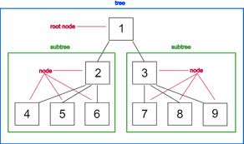
Ordered Trees
A tree is ordered if there is a linear ordering defined for children of each node
Children of a node can be identified as being first, second, third, etc.
Visualized by arranging siblings from left to right
Example: A book/chapters/sections

Slide 9
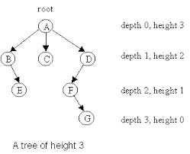
Depth of a Node
The depth of a node p in a tree T is defined as
Number of ancestors excluding p itself
If v is the root, then its depth is 0;
Otherwise, its depth of p is one plus the depth of its parent

Slide 10

Height of a Node
The height of a node p in a tree T is defined as
Maximum depth of any node
The height of a nonempty tree T is equal to the maximum depth of an external (a.k.a. leaf) node of T

Slide 11

Binary Trees

Slide 12
Binary Trees
Applications:
Arithmetic expressions
Decision processes
Searching
A binary tree is an ordered tree with the following properties
Each node has at most two children
Each child node is labeled as being either a left or right child
A left child precedes a right child in the ordering of the children of the node
The subtree rooted at a left or right child is called a left subtree or right subtree respectively
A
B
C
D
E
F
G
H
I

Slide 13
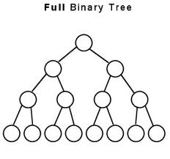
More on Binary Trees
A binary tree is proper (or full) if each node has either zero or two children
Every internal node has exactly two children

Slide 14
Decision Tree
Binary tree can be associated with a decision process
Internal nodes: questions with yes/no answer
External nodes: decisions
Example: dining decision
Going to Lunch
Yes
No
Student Budget?
On expense account?
Yes
No
Yes
No
McDonalds
Subway
Ruth Chris
Outback

Slide 15
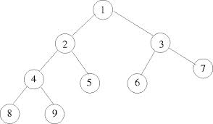
Recursive Binary Tree Definition
Binary tree is empty or consists of
A node r, called the root of T and storing an element
A binary tree, called the left subtree
A binary tree, called the right subtree

Slide 16
Tree Traversal Algorithms

Slide 17
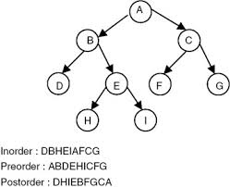
Tree Traversal
Tree traversal is the process of visiting each node in the tree exactly once
There are several ways to traverse a tree.
Preorder, postorder, inorder, depth-first, and breadth-first traversals

Slide 18
Preorder Traversal
A traversal visits the nodes of a tree in a systematic manner
In a preorder traversal, a node is visited before its descendants
Application: print a structured document
Algorithm preOrder(v)
visit(v)
for each child w of v
preorder (w)
1
Make Money Fast!
2
5
9
1. Motivations
2. Methods
References
3
4
6
7
8
1.1 Greed
1.2 Avidity
2.1 Stock Fraud
2.2 Ponzi Scheme
2.3 Bank Robbery
The depth-first is the same as the preorder

Slide 19
Another Preorder Example
1
2
7
3
4
8
9
5
6

Slide 20
Postorder Traversal
In a postorder traversal, a node is visited after its descendants
Application: compute space used by files in a directory and its subdirectories
Algorithm postOrder(v)
for each child w of v
postOrder (w)
visit(v)
9
cs16/
8
3
7
homeworks/
programs/
todo.txt 1K
1
2
4
5
6
h1c.doc 3K
h1nc.doc 2K
DDR.cpp 10K
Stocks.cpp 25K
Robot.cpp 20K

Slide 21
Inorder Traversal
In an inorder traversal a node is visited after its left subtree and before its right subtree
Application: draw a binary tree
x(v) = inorder rank of v
y(v) = depth of v
Algorithm inOrder(v)
if ¬ v.isExternal()
inOrder(v.left())
visit(v)
if ¬ v.isExternal()
inOrder(v.right())
6
2
8
1
4
7
9
3
5

Slide 22
Inorder Traversal Example
58
42
70
38
50
68
72
47
52
Inorder traversals of the internal nodes visit the elements in non-decreasing order (38,42,47,50,52,58,68,70,72)

Slide 23
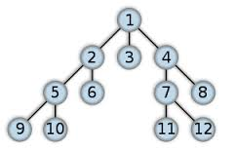
Breadth-first Tree Traversals
The breadth-first traversal is to visit the nodes level by level
First visit the root, then all children of the root from left to right, then grandchildren of the root from left to right, and so on

Slide 24
Tree Traversal Example
.
60
55
100
45
57
67
107
59
101
The inorder is 45 55 57 59 60 67 100 101 107
The postorder is 45 59 57 55 67 101 107 100 60
The preorder is 60 55 45 57 59 100 67 107 101
The breadth-first traversal is 60 55 100 45 57 67 107 59 101

Slide 25
Another Traversal Example
33
22
55
13
34
height 2
Inorder 13 22 33 34 55
Preorder 33 22 13 55 34
Postorder 13 22 34 55 33
breadth-first 33 22 55 13 34

Slide 26
Arithmetic Expression Tree
Binary tree associated with an arithmetic expression
internal nodes: operators
external nodes: operands
Example: arithmetic expression tree for the expression (2 × (a - 1) + (3 × b))
See example 7.9
+
×
×
Inorder traversal
2
−
3
b
a
1

Slide 27
Binary Search Trees
<
6
2
>
9
1
4
=
8

Slide 28
Binary Search Trees
A binary search tree is a binary tree storing keys (or key-value entries) at its internal nodes and satisfying the following property:
Let u, v, and w be three nodes such that u is in the left subtree of v and w is in the right subtree of v. We have key(u) ≤ key(v) ≤ key(w)
External nodes do not store items
An inorder traversal of a binary search trees visits the keys in increasing order
6
2
9
1
4
8

Slide 29
Searching
To search for a key k in a map or dictionary, one traces a downward path starting at the root (decision tree)
The next node visited depends on the outcome of the comparison of k with the key of the current node
If we reach a leaf, the key is not found and we return null
Example: find(4):
Call TreeSearch(4,root)
Algorithm TreeSearch(k, v)
if T.isExternal (v)
return v
if k < key(v)
return TreeSearch(k, T.left(v))
else if k > key(v) then
return TreeSearch(k, T.right(v))
return v {k = key(v)}
<
6
2
>
9
1
4
=
8

Slide 30

Insertion
Insert the element e at the external node v and expand v to be internal, having new (empty) external node children

Slide 31
Insertion Example
insert 5
6
<
2
>
9
1
4
>
8
w
6
2
9
1
4
8
w
5

Slide 32
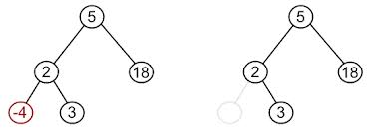
Removal
One needs to avoid creating “holes” in the binary search tree

Slide 33

Removal (Case 1)
If one of the children of a node w is an external node, say z, one simply removes w and z

Slide 34
Removal Example 1
remove 4
<
6
2
>
9
1
4
v
8
w
5
6
2
9
1
5
8

Slide 35

Removal (Case 2) (1)
If both children of node w are internal nodes
One cannot remove w since it would create a hole
One finds the internal node y that follows w in an inorder traversal
Node y is the left most internal node in the right subtree of w
The left child x of y is the external node that immediately follows node w in the in-order traversal

Slide 36

Removal (Case 2) (2)
If the right sub-tree does not have a left most node then replace w with the right most node of the left sub-tree
One moves y into w
One removes nodes y and its left child x (which must be a leaf)

Slide 37
Removal Example 2
1
w
remove 3
3
2
8
6
9
y
5
x
1
v
5
2
8
6
9

